Slide 1
UPPER SIXTH ARTS
GEOGRAPHY
Lesson 8
Historical Evolution of World Population
Notes:
Good morning, class, and welcome to our geography lesson. I am your geography teacher, Mr Kamdem. Today we are starting Lesson 8: Historical Evolution of World Population.

Slide 2
CLASS INFO
Class, Chapter and Duration
Class | Upper Sixth Arts
Chapter | Module 4: Understanding and managing population dynamics across the world in general and Cameroon in particular
Duration | 2 periods (2 × 50 minutes)
Notes:
This lesson is for Upper Sixth Arts. It belongs to Module 4: Understanding and managing population dynamics across the world in general and Cameroon in particular. We shall need 2 periods to cover it.

Slide 3
IDENTIFICATION
Lesson Identification
Topic | Population Change over Time (Population Growth)
Sub-topic | The World's Population
Lesson | Lesson 8: Historical Evolution of World Population
Notions / Concepts | Population growth, Industrial Revolution, J-curve, MEDCs, LEDCs.
Syllabus focus | Global trends before and after the Industrial Revolution; regional trends (slow in MEDCs, fast in LEDCs).
Competence | Learners are able to describe and explain the growth of world population over time.
Notes:
Our topic is Population Change over Time (Population Growth), and the sub-topic is The World's Population. The key notions we shall use today are: population growth, Industrial Revolution, J-curve, MEDCs, LEDCs. At the end, you should be able to do this: learners are able to describe and explain the growth of world population over time.

Slide 4

HOMEWORK CORRECTION
Correction of the Homework
Question (Practical Work 3: Dependency Ratio and Population Pyramids):
Draw the pyramid of the town on graph paper and write a short report.
Notes:
Before we start the new lesson, let us correct the homework I gave you at the end of Practical Work 3: Dependency Ratio and Population Pyramids. The question was: Draw the pyramid of the town on graph paper and write a short report. Take out your exercise books.

Slide 5
HOMEWORK CORRECTION
Correction: Possible Answer
The town pyramid has a wide base and a narrow top (expansive). The dependency ratio is high (above 80), so many children depend on workers; the town needs schools and jobs.
Notes:
Here is a good answer. The town pyramid has a wide base and a narrow top (expansive). The dependency ratio is high (above 80), so many children depend on workers; the town needs schools and jobs. Compare it with your own answer and correct your work in red.

Slide 6
LESSON PLAN
Lesson Plan
Correction of the homework
Objectives and recall
Real-life situation and action to take
Learning activities
Board summary
Evaluation, remediation and homework
Notes:
Here is the plan of our lesson today. First, we shall correct the homework. Then we shall look at the objectives and recall what you already know. After that, we shall study a situation from real life and the action to take, and do the learning activities. Finally, we shall copy the board summary, do the evaluation and the remediation, and I will give you the homework.

Slide 7
OBJECTIVES
Objectives
By the end of this lesson, you should be able to:
Describe world population growth over time.
Explain the effect of the Industrial Revolution.
Notes:
Take your time to copy this part; we will continue together.

Slide 8
OBJECTIVES
Objectives (continued)
Compare growth in MEDCs and LEDCs.
Notes:
By the end of this lesson, you should be able to do three things. Number 1: describe world population growth over time. Number 2: explain the effect of the Industrial Revolution. Number 3: compare growth in MEDCs and LEDCs.

Slide 9
PREVIOUS KNOWLEDGE
Previous Knowledge
World population is about 8 billion.
Africa grows fastest today.
Notes:
Let us first remember what you already know. World population is about 8 billion. Africa grows fastest today. Keep this in mind, because we shall build on it today.

Slide 10
REAL-LIFE SITUATION
Situation in Real Life
It took all of human history until 1800 for the world to reach 1 billion people, but only 12 years to go from 7 to 8 billion. Learners wonder what changed.
Notes:
Listen carefully to this situation from real life. It took all of human history until 1800 for the world to reach 1 billion people, but only 12 years to go from 7 to 8 billion. Learners wonder what changed. Think about it, because I am going to ask you some questions.

Slide 11
REAL-LIFE SITUATION
Situation: Question 1
What is the problem in the situation?
Notes:
Question 1: What is the problem in the situation? Think for a moment, then raise your hand to answer.

Slide 12
REAL-LIFE SITUATION
Answer
Population growth has become very fast.
Notes:
Good. Population growth has become very fast.

Slide 13
REAL-LIFE SITUATION
Situation: Question 2
What event started the fast growth?
Notes:
Question 2: What event started the fast growth? Think for a moment, then raise your hand to answer.

Slide 14
REAL-LIFE SITUATION
Answer
The Industrial Revolution.
Notes:
Good. The Industrial Revolution.

Slide 15
REAL-LIFE SITUATION
Situation: Question 3
Where is growth fastest today?
Notes:
Question 3: Where is growth fastest today? Think for a moment, then raise your hand to answer.

Slide 16
REAL-LIFE SITUATION
Possible Answer
In LEDCs, especially Africa.
Notes:
Good. In LEDCs, especially Africa.

Slide 17
ACTION TO TAKE
Action to Take
Understand the history of population growth to prepare for the future.
Notes:
From this situation, the action we are working towards in this lesson is the following: understand the history of population growth to prepare for the future.

Slide 18
JUSTIFICATION
Justification of the Lesson
This lesson helps us to understand how and why world population grew so fast.
Notes:
Why is this lesson important for you? This lesson helps us to understand how and why world population grew so fast.

Slide 19
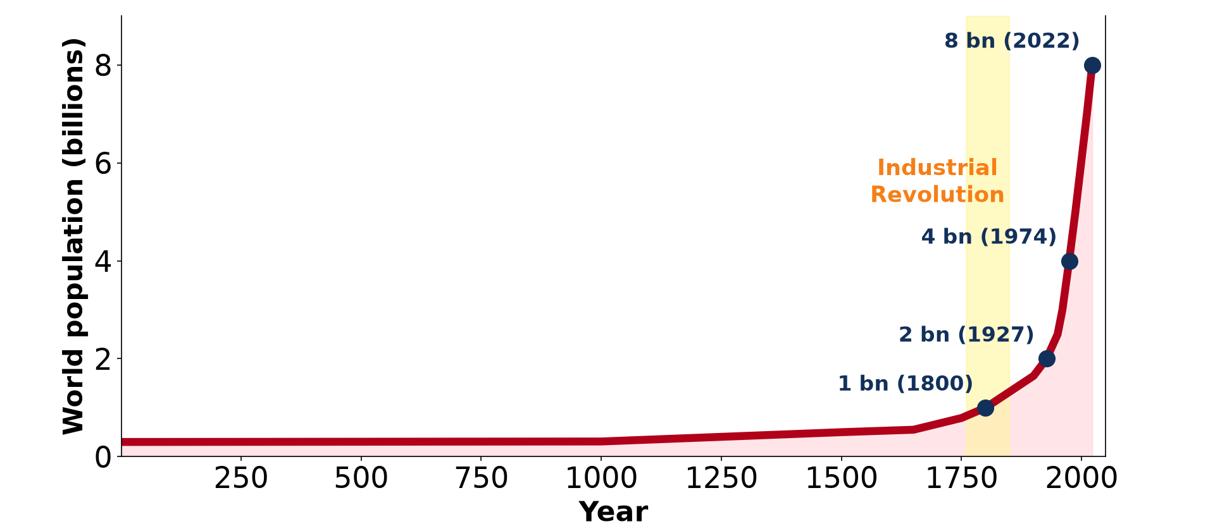
1. GLOBAL TRENDS
Activity 1
World population from year 1 to today.
Notes:
Activity 1. Look carefully at this diagram: world population from year 1 to today. Observe every detail before I ask the question.

Slide 20
1. GLOBAL TRENDS
Activity 1: Question
When did world population reach 1 billion? When did it reach 8 billion?
Notes:
Here is the question for Activity 1: When did world population reach 1 billion? When did it reach 8 billion? Take one minute to think and write your answer in your rough notebook.

Slide 21
1. GLOBAL TRENDS
Activity 1: Answer
About 1800; in 2022.
Notes:
Let us check the answer together. About 1800; in 2022.

Slide 22
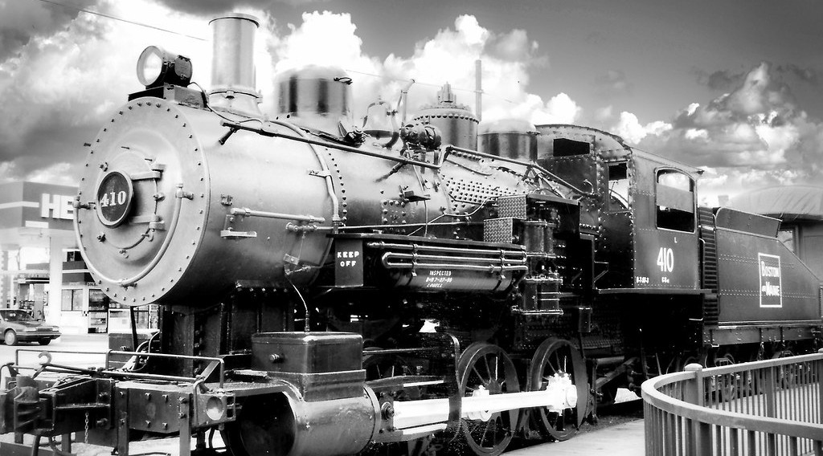
2. THE INDUSTRIAL REVOLUTION
Activity 2
A steam locomotive of the industrial age.
Notes:
Activity 2. Look carefully at this picture: a steam locomotive of the industrial age. Observe every detail before I ask the question.

Slide 23
2. THE INDUSTRIAL REVOLUTION
Activity 2: Question
How did the Industrial Revolution increase population?
Notes:
Here is the question for Activity 2: How did the Industrial Revolution increase population? Take one minute to think and write your answer in your rough notebook.

Slide 24
2. THE INDUSTRIAL REVOLUTION
Activity 2: Answer
More food, better transport, jobs and later better health.
Notes:
Let us check the answer together. More food, better transport, jobs and later better health.

Slide 25

2. AFTER THE INDUSTRIAL REVOLUTION
Activity 3
A child being vaccinated.
Notes:
Activity 3. Look carefully at this picture: a child being vaccinated. Observe every detail before I ask the question.

Slide 26
2. AFTER THE INDUSTRIAL REVOLUTION
Activity 3: Question
Why did death rates fall in the 20th century?
Notes:
Here is the question for Activity 3: Why did death rates fall in the 20th century? Take one minute to think and write your answer in your rough notebook.

Slide 27
2. AFTER THE INDUSTRIAL REVOLUTION
Activity 3: Answer
Vaccines, medicines, clean water and better food.
Notes:
Let us check the answer together. Vaccines, medicines, clean water and better food.

Slide 28
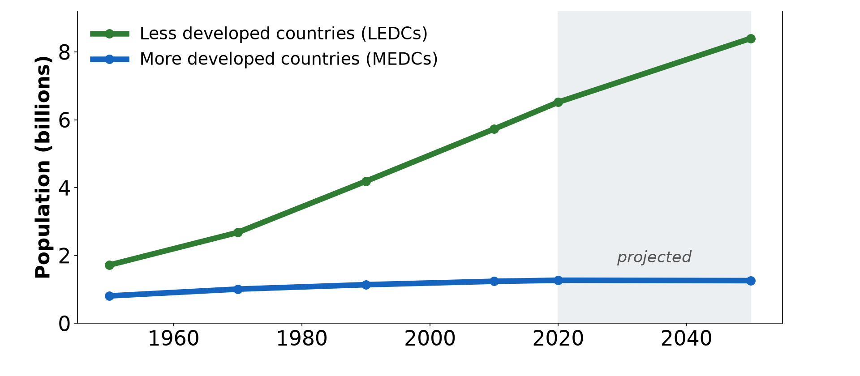
3. REGIONAL TRENDS
Activity 4
Population of MEDCs and LEDCs, 1950–2050.
Notes:
Activity 4. Look carefully at this diagram: population of MEDCs and LEDCs, 1950–2050. Observe every detail before I ask the question.

Slide 29
3. REGIONAL TRENDS
Activity 4: Question
Compare the growth of MEDCs and LEDCs since 1950.
Notes:
Here is the question for Activity 4: Compare the growth of MEDCs and LEDCs since 1950. Take one minute to think and write your answer in your rough notebook.

Slide 30
3. REGIONAL TRENDS
Activity 4: Answer
MEDCs grow slowly; LEDCs grow fast.
Notes:
Let us check the answer together. MEDCs grow slowly; LEDCs grow fast.

Slide 31
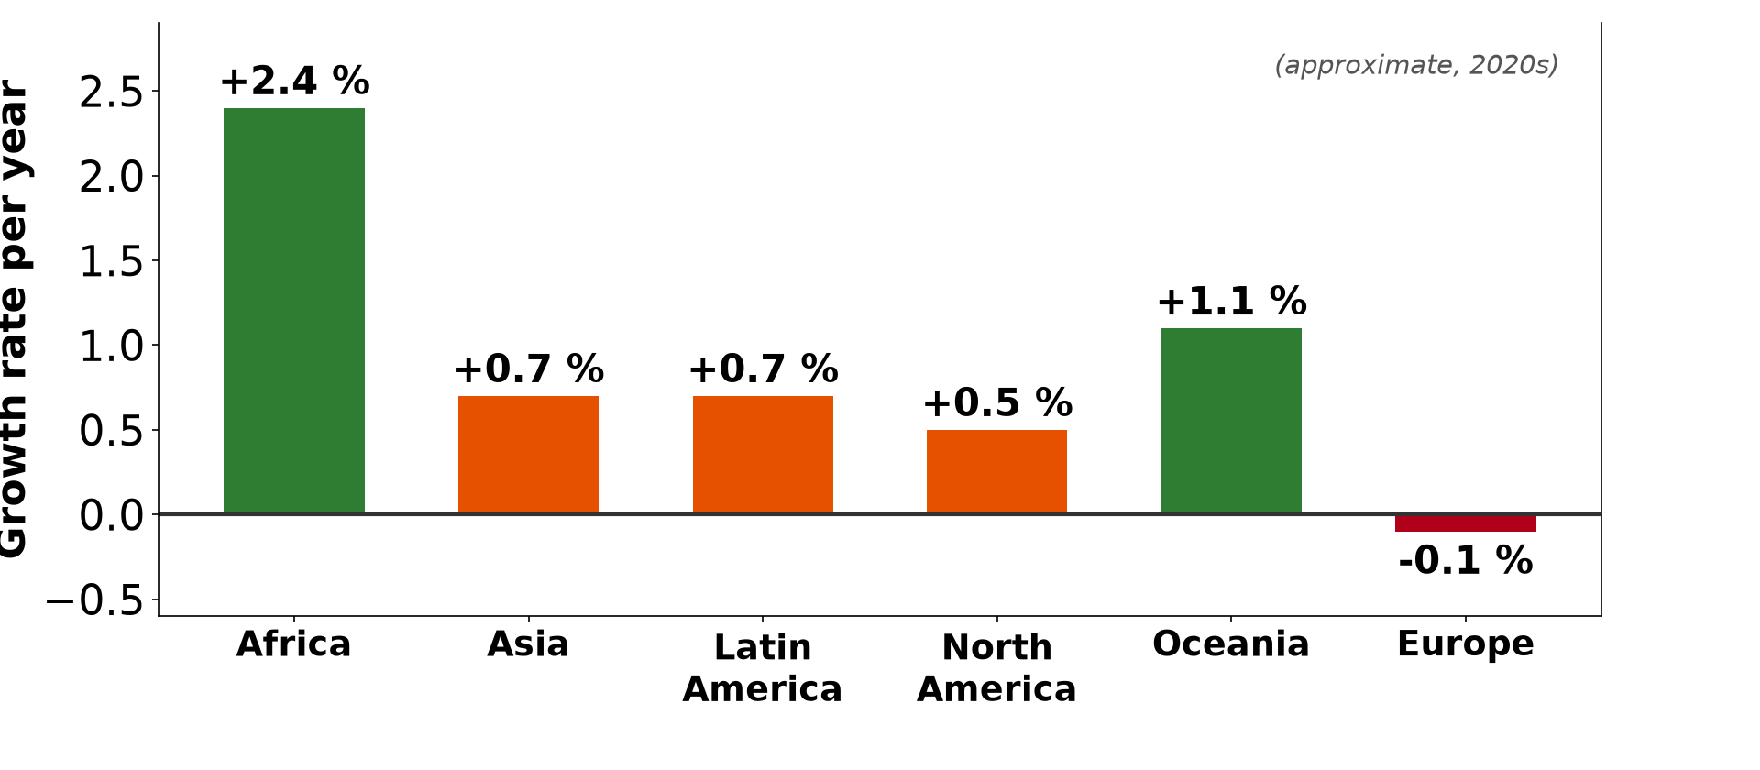
3. REGIONAL TRENDS
Activity 5
Growth rates by continent.
Notes:
Activity 5. Look carefully at this diagram: growth rates by continent. Observe every detail before I ask the question.

Slide 32
3. REGIONAL TRENDS
Activity 5: Question
Why does Africa grow faster than Europe?
Notes:
Here is the question for Activity 5: Why does Africa grow faster than Europe? Take one minute to think and write your answer in your rough notebook.

Slide 33
3. REGIONAL TRENDS
Activity 5: Answer
High birth rates and falling death rates.
Notes:
Let us check the answer together. High birth rates and falling death rates.

Slide 34
BOARD SUMMARY
Board Summary
Topic: Population Change over Time (Population Growth)
Sub-topic: The World's Population
Lesson 8: Historical Evolution of World Population
Notes:
Now we are going to copy the board summary. Write the title and the headings neatly in your notebooks. I will give you enough time for each slide, so do not rush.

Slide 35
BOARD SUMMARY
1. Global Trends before the Industrial Revolution
World population grew slowly for a long time:
Slow growth: Until about 1750, high birth and death rates kept growth very slow. Famines, wars and epidemics such as the plague reduced population.
Notes:
Let us copy Global Trends before the Industrial Revolution. World population grew slowly for a long time. On this slide we have Slow growth. Write each point on a new line, with the key term first, and explain it in your own words when we revise. When you finish, we go to the next slide.

Slide 36
BOARD SUMMARY
1. Global Trends before the Industrial Revolution (continued)
Milestones: The world reached 1 billion around 1804 and 2 billion in 1927. Growth then became faster and faster.
Notes:
We continue with Global Trends before the Industrial Revolution. On this slide we have Milestones. Write each point on a new line, with the key term first, and explain it in your own words when we revise.

Slide 37
BOARD SUMMARY
1. Global Trends before the Industrial Revolution
Illustration: growth of world population
Notes:
Now draw this illustration in your notebook: growth of world population. Give it a title and label it clearly.

Slide 38
BOARD SUMMARY
2. During and after the Industrial Revolution
Growth accelerated for the following reasons:
Industrial Revolution: Better farming, food supply, transport and sanitation reduced death rates in Europe. Population grew quickly in the 19th century.
Notes:
Let us copy During and after the Industrial Revolution. Growth accelerated for the following reasons. On this slide we have Industrial Revolution. Write each point on a new line, with the key term first, and explain it in your own words when we revise. When you finish, we go to the next slide.

Slide 39
BOARD SUMMARY
2. During and after the Industrial Revolution (continued)
20th century to present: Vaccines, antibiotics and clean water spread worldwide after 1950, so death rates fell everywhere. The world reached 8 billion in 2022.
Notes:
We continue with During and after the Industrial Revolution. On this slide we have 20th century to present. Write each point on a new line, with the key term first, and explain it in your own words when we revise.

Slide 40
BOARD SUMMARY
3. Regional Trends
Growth differs between regions:
MEDCs: Growth is slow or negative, because birth rates are low. Europe and Japan are ageing.
Notes:
Let us copy Regional Trends. Growth differs between regions. On this slide we have MEDCs. Write each point on a new line, with the key term first, and explain it in your own words when we revise. When you finish, we go to the next slide.

Slide 41
BOARD SUMMARY
3. Regional Trends (continued)
LEDCs: Growth is faster, especially in Africa, where birth rates remain high while death rates have fallen. Asia and Latin America are slowing down.
Notes:
We continue with Regional Trends. On this slide we have LEDCs. Write each point on a new line, with the key term first, and explain it in your own words when we revise.

Slide 42
BOARD SUMMARY
3. Regional Trends
Illustration: growth of MEDCs and LEDCs
Notes:
Now draw this illustration in your notebook: growth of MEDCs and LEDCs. Give it a title and label it clearly.

Slide 43
FORMATIVE EVALUATION
Evaluation 1
When did the world reach 1 and 8 billion people?
Notes:
Now let us check what you have understood. Question 1: When did the world reach 1 and 8 billion people? Answer in your exercise book.

Slide 44
FORMATIVE EVALUATION
Expected Answer
About 1800 and 2022.
Notes:
The expected answer is: about 1800 and 2022. If you got it right, well done.

Slide 45
FORMATIVE EVALUATION
Evaluation 2
Why do LEDCs grow faster than MEDCs?
Notes:
Now let us check what you have understood. Question 2: Why do LEDCs grow faster than MEDCs? Answer in your exercise book.

Slide 46
FORMATIVE EVALUATION
Expected Answer
Birth rates stay high while death rates have fallen.
Notes:
The expected answer is: birth rates stay high while death rates have fallen. If you got it right, well done.

Slide 47
REMEDIATION
Remediation
Fill in the blanks:
The growth curve of world population is a ______-curve.
Fast growth began after the ______ Revolution.
Today the fastest growth is in ______.
Notes:
For those who need more practice, fill in the blanks in your exercise book. The answers are: number 1, J; number 2, Industrial; number 3, Africa.

Slide 48
HOMEWORK
Homework
Draw a timeline of world population from 1800 to 2022.
Notes:
For your homework: Draw a timeline of world population from 1800 to 2022. We shall correct it at the beginning of our next lesson.

Slide 49
NEXT LESSON
Next Lesson
Our next lesson will be on:
Lesson 9: Population Growth and its Determinants
Notes:
Our next lesson will be on Lesson 9: Population Growth and its Determinants. Thank you for your attention, and see you next time.

Slide 50
BILINGUAL GAME
Bilingual Game (Jeu Bilingue)
English | Français
Growth | La croissance
Billion | Le milliard
Revolution | La révolution
Vaccine | Le vaccin
Trend | La tendance
Century | Le siècle
Notes:
Let us play the bilingual game. I say a word in English, and you give me the French word. Then we do the reverse.

Slide 51
LOGBOOK
Official Logbook (1/2)
Module / Topic | Population Change over Time (Population Growth)
Lesson Title | Lesson 8: Historical Evolution of World Population
Expected Learning Outcomes | Describe world population growth over time. Explain the effect of the Industrial Revolution. Compare growth in MEDCs and LEDCs.
Competence | Learners are able to describe and explain the growth of world population over time.
Notes:
I record this information in the official logbook of the class after the lesson.

Slide 52
LOGBOOK
Official Logbook (2/2)
Matter Taught | Global Trends before the Industrial Revolution; During and after the Industrial Revolution; Regional Trends.
Evaluation | Formative evaluation and remediation exercise.
Homework | Draw a timeline of world population from 1800 to 2022.
Enrolment / Present / Absent | ____ / ____ / ____
Achievement | To be completed after the lesson.
Notes:
I complete the second page of the logbook: the matter taught, the evaluation, the homework and the attendance.

Slide 53
TEACHER'S NOTE
Teacher's Note
Timing: Homework correction, plan, objectives 8 min | Recall, situation, action 10 min | 5 activities 30 min | Board summary (copying) 30 min | Evaluation, remediation 10 min | Homework, next lesson 5 min | Logbook 7 min
Without the projector (Activity 1): draw the J-curve.
Without the projector (Activity 2): list inventions of the 1800s.
Without the projector (Activity 3): list diseases now prevented.
Without the projector (Activity 4): read the two lines.
Without the projector (Activity 5): compare birth rates.
Notes:
This slide is for me, the teacher: it gives the timing of the lesson and what to do if the projector is not available.

Slide 54
REFERENCES
References
National Geography Syllabus, MINESEC/IGE/IP-SS, 2019 — Module 4 (Population Geography).
Photo, Activity 2: “Lowell Massachusetts - Boston & Maine Railroad - Steam Engine - Monoch” by Onasill - Bill Badzo - 149 Million Views - Thank Y, CC BY-NC-SA 2.0, via Flickr (https://www.flickr.com/photos/7156765@N05/51797580418)
Photo, Activity 3: “Isatu gets a vaccination for her 5 week old son” by World Bank Photo Collection, CC BY-NC-ND 2.0, via Flickr (https://www.flickr.com/photos/10816734@N03/26372818523)
Diagrams and animations: drawn for this lesson (Geography Department).
Notes:
These are the references and picture credits used to prepare this lesson.

